Slide 1

What is perfSONAR
A collaboration
  Production network operators focused on designing and building tools that they will deploy and use on their networks to provide monitoring and diagnostic capabilites to themselves and their user comunities.
An architecture & a set of protocols
  Web Services Architecture
  Protocols based on the Open Grid Forum Network Measurement Working Group Schemas
Several interoperable software implementations based on the OGF protocols
  Java & Perl
A Deployed Measurement infrastructure

Slide 2
perfSONAR Collaboraters
RNP
ARNES
BELNET
CARNET
CESNET
CYNET
DANTE
DFN
ESnet
FCCN
FERMI
GARR
GEANT
GRNET
HEAnet
Internet2
ISTF
POZNAN
UNINETT
University of Delaware
Renater
RedIRIS
SLAC
SWITCH
SURFnet
And anybody else I missed

Slide 3
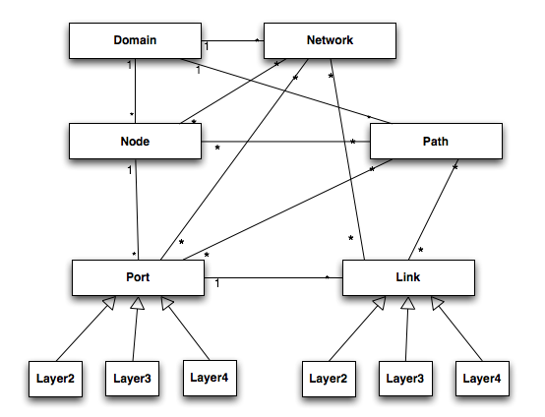
Schema

Slide 4
Schema - Network Element Identifiers
A scheme for identifying network elements
Each network element gets a unique identifier
This identifier will be included with any measurement associated with that element.

Slide 5
Network Element Identifiers
Use Cases:
  A topology service can be used to find the identifier for a network element
  An LS could then be queried to find all measurements associated with that element
  Dynamic service path-finding can be integrated with ongoing measurements

Slide 6
Network Element Identifiers
Identifiers use URN notation
  Prefixed with “urn:ogf:network:”
  Consists of name/value pairs separated by colons
  Possible field names: domain, node, port, link, path, network
  Set of rules defined for each field to keep identifiers compact and finite

Slide 7
Network Element Identifiers
Examples
  urn:ogf:network:domain=internet2.edu
  urn:ogf:network:domain=internet2.edu:node=packrat
  urn:ogf:network:domain=internet2.edu:node=rtr.seat:port=so-2%2F1%2F0.16
  urn:ogf:network:domain=internet2.edu:node=rtr.seat:port=198.32.8.200
  urn:ogf:network:domain=Internet2.edu:node=packrat:port=eth0:link=1
  urn:ogf:network:domain=internet2.edu:link=WASH_to_ATLA_OC192
  urn:ogf:network:path=anna-11537-176

Slide 8
Topology Service
Provides a queryable repository for obtaining topology information
  Can obtain the full set of known topology information
  XQuery interface allows the construction of complex queries about the network

Slide 9
Topology Service
Current Deployments
  Internet2
Planned Deployments
  DICE DCN Sites
  ESnet
  SLAC (PingER Topology Information)

Slide 10
Oscars Circuit plugin

Slide 11
perfSONAR-PS Beta Release (0.06) (1/21/08)
Focus on development of major perfSONAR components
  LS - perfSONAR_PS::Services::LS::LS
  SNMP MA - perfSONAR_PS::Services::MA::SNMP
  Status MA - perfSONAR_PS::Services::MA::Status
  CircuitStatus MA - perfSONAR_PS::Services::MA::CircuitStatus
  Topology MA - perfSONAR_PS::Services::MA::Topology

Slide 12
Summary
Schema/Identification scheme
Topology Service and clients that use it
Beta Release of the perfSONAR Services available on CPAN

Slide 13
Questions?
Aaron Brown
  aaron@internet2.edu
Martin Swany
  swany@cis.udel.edu

Slide 14


